Slide 1
OBSTETRICS AND GYNECOLOGY
RESIDENCY PROGRAM
2024-2025

Slide 2
ABOUT OUR PROGRAM
Community-based program
7 residency programs
Long-standing history of osteopathic education since 1942
Current campus since 2008
208 inpatient beds
150 births/month; 1800 births/year (all with resident coverage)
3 ob/gyn residents per year

Slide 3
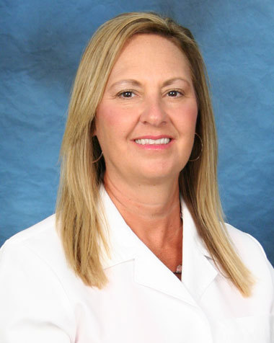
MEET OUR PROGRAM DIRECTOR
DR. RENEE ELDERKIN, MD, FACOOG

Slide 4
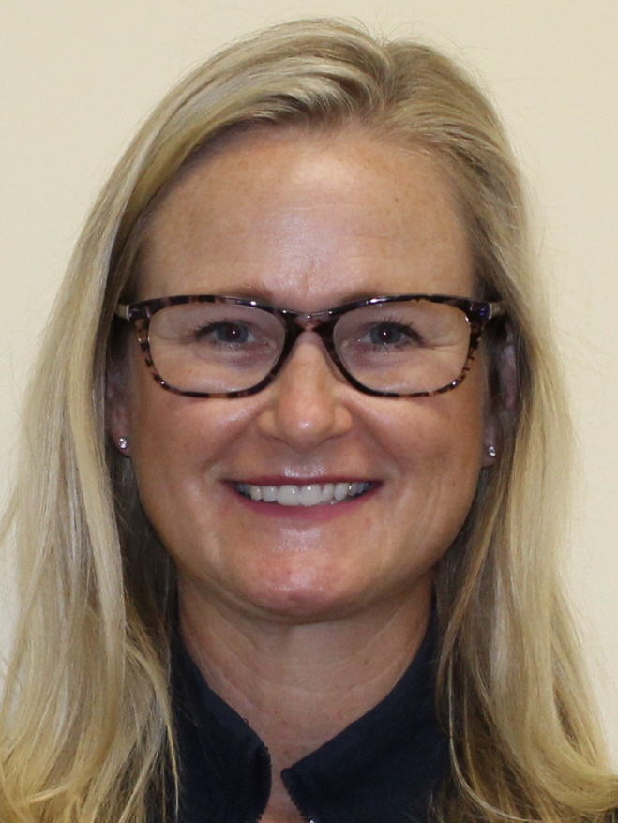
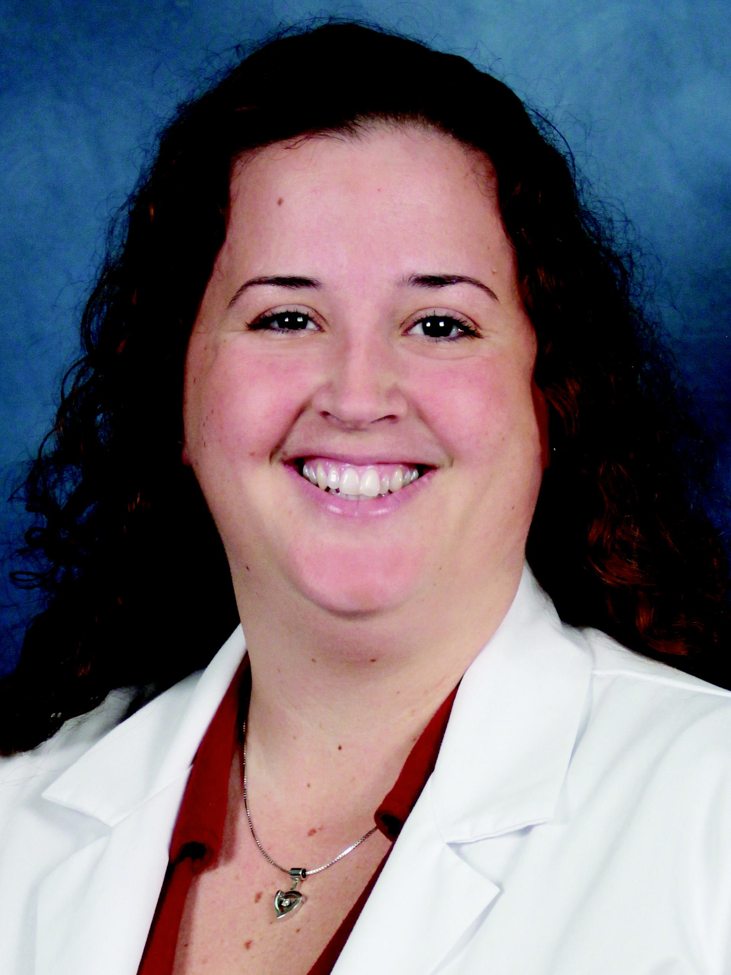
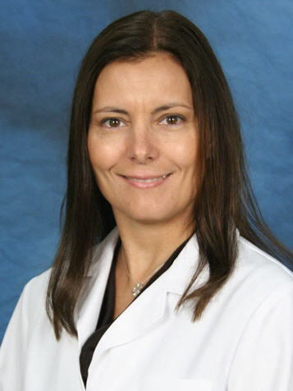
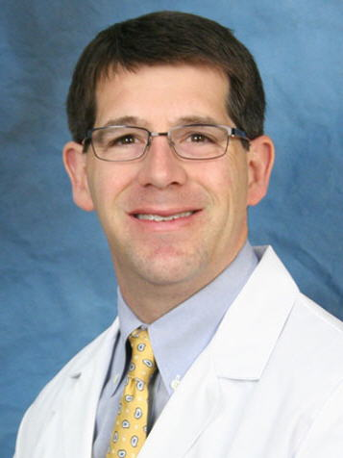
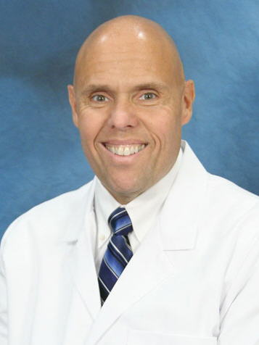
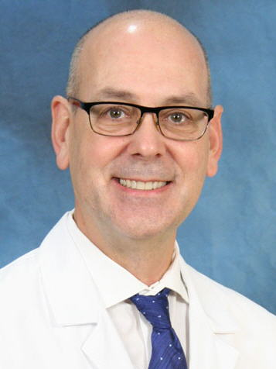
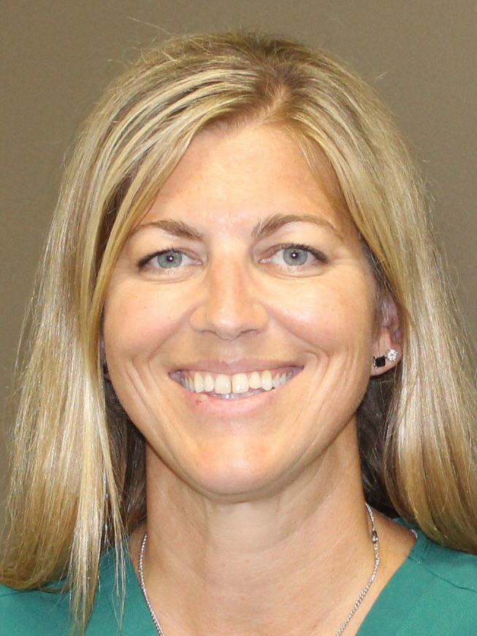
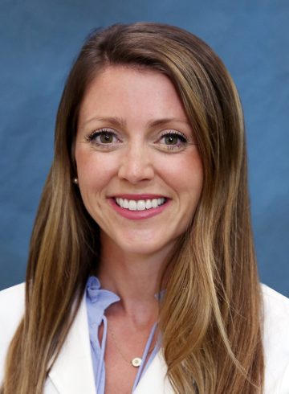
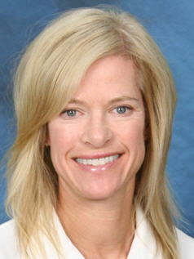
MEET OUR ATTENDINGS
Dr. Judy Florido
Dr. Stephanie Getz
Dr. Kelly Hansul
Dr. Brad Irving
Dr. Pete Kaczkofsky
Dr. Steve Lown
Dr. Tracie Rulewicz
Dr. Maia Sullivan
Dr. Susan Vandenbosch

Slide 5
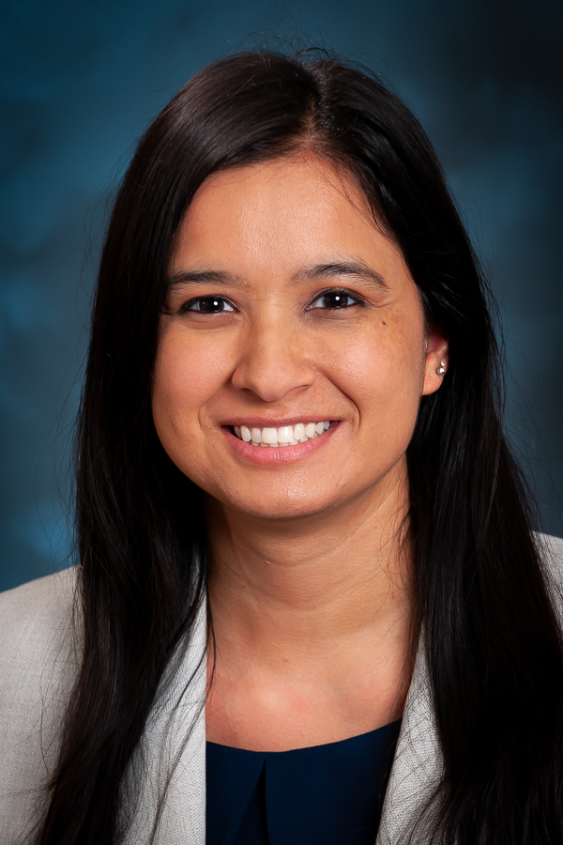
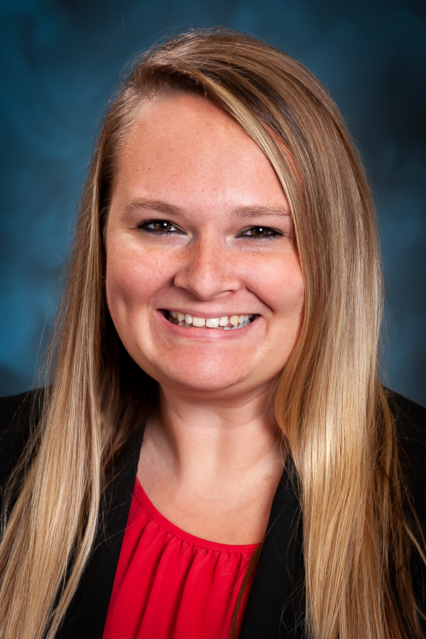
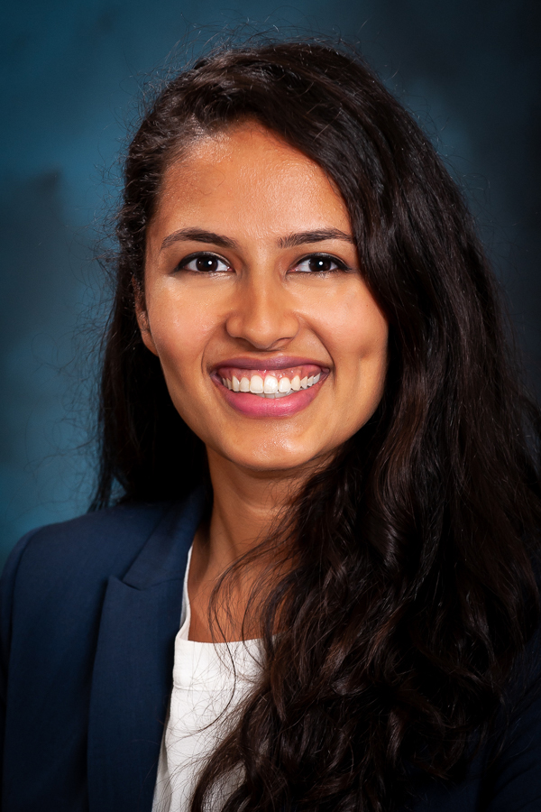
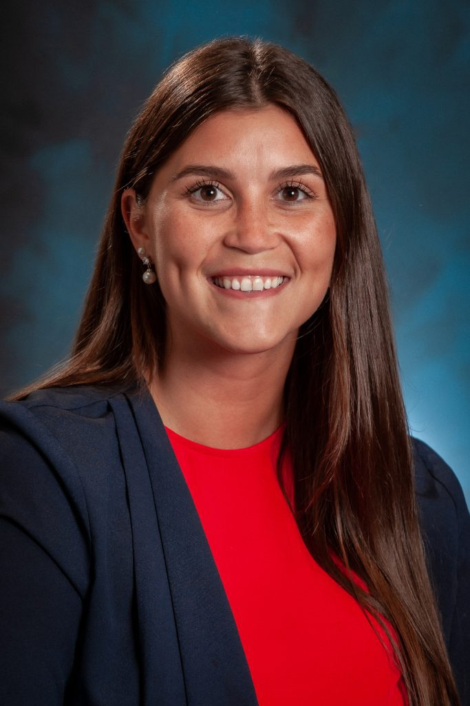
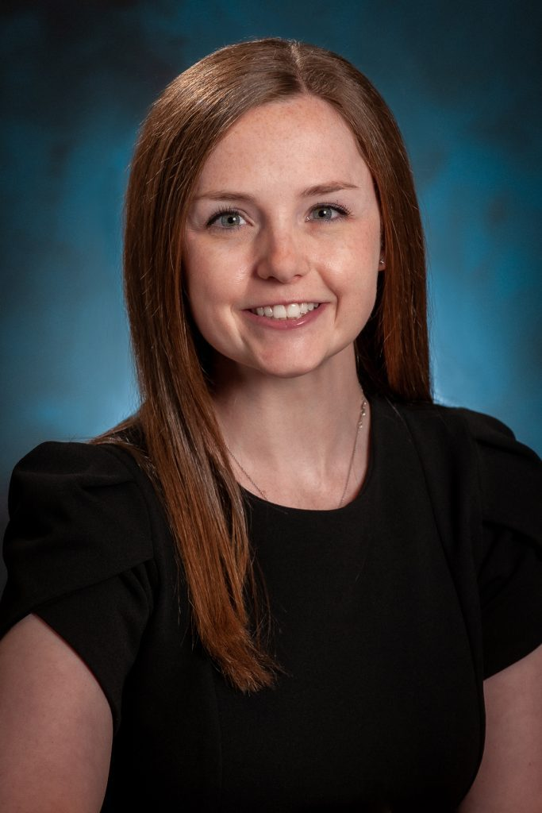
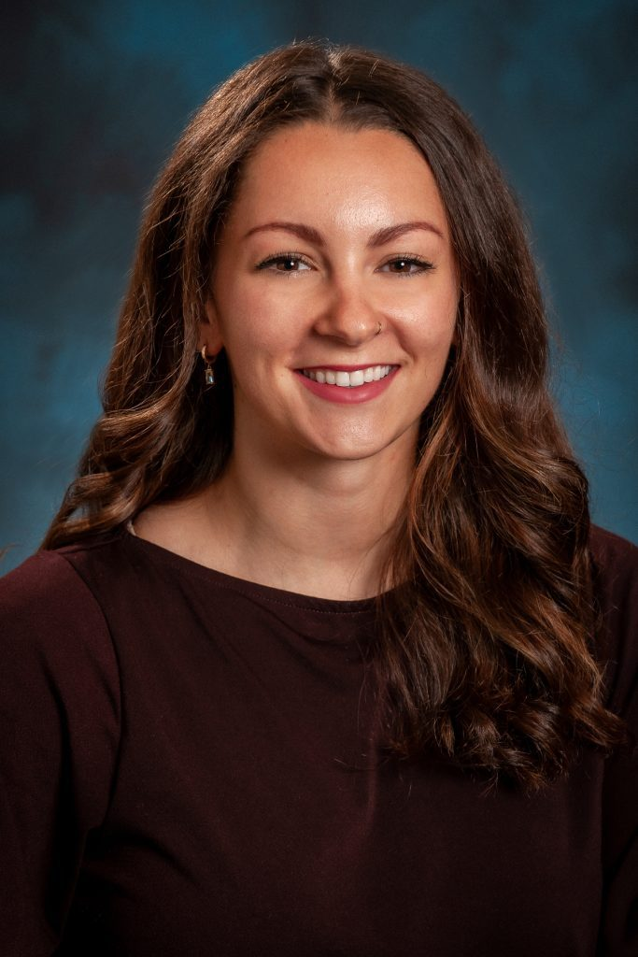
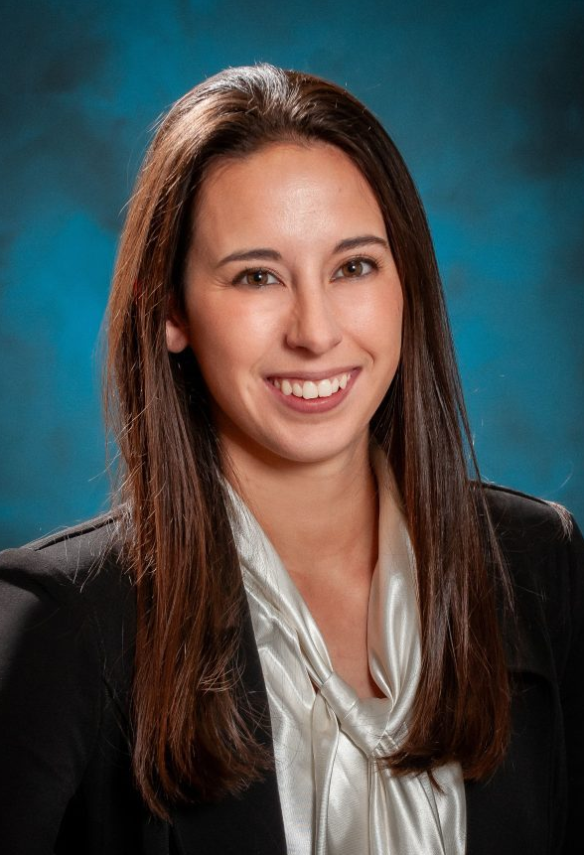
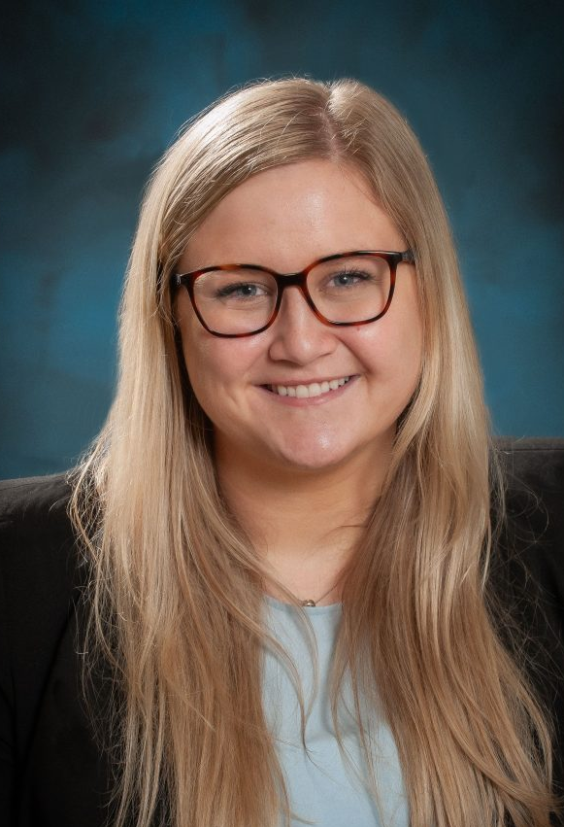
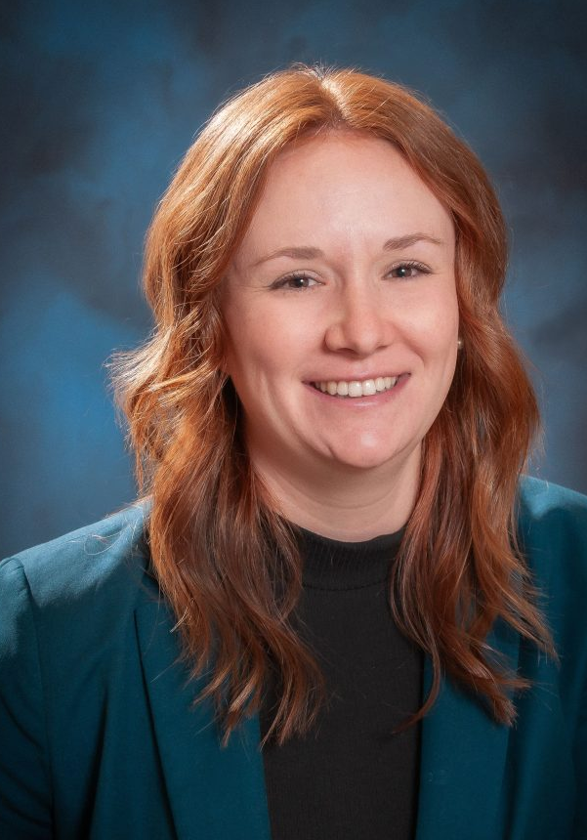
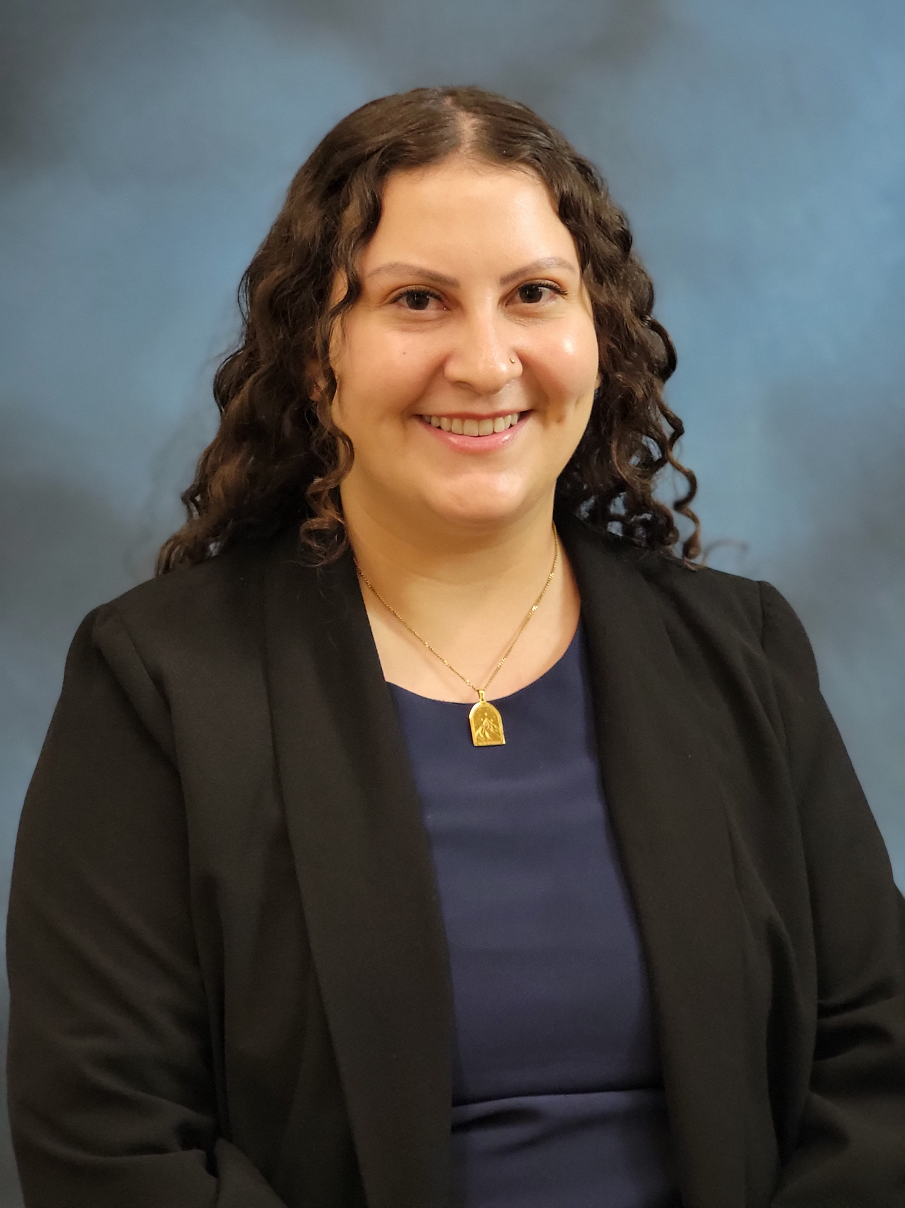
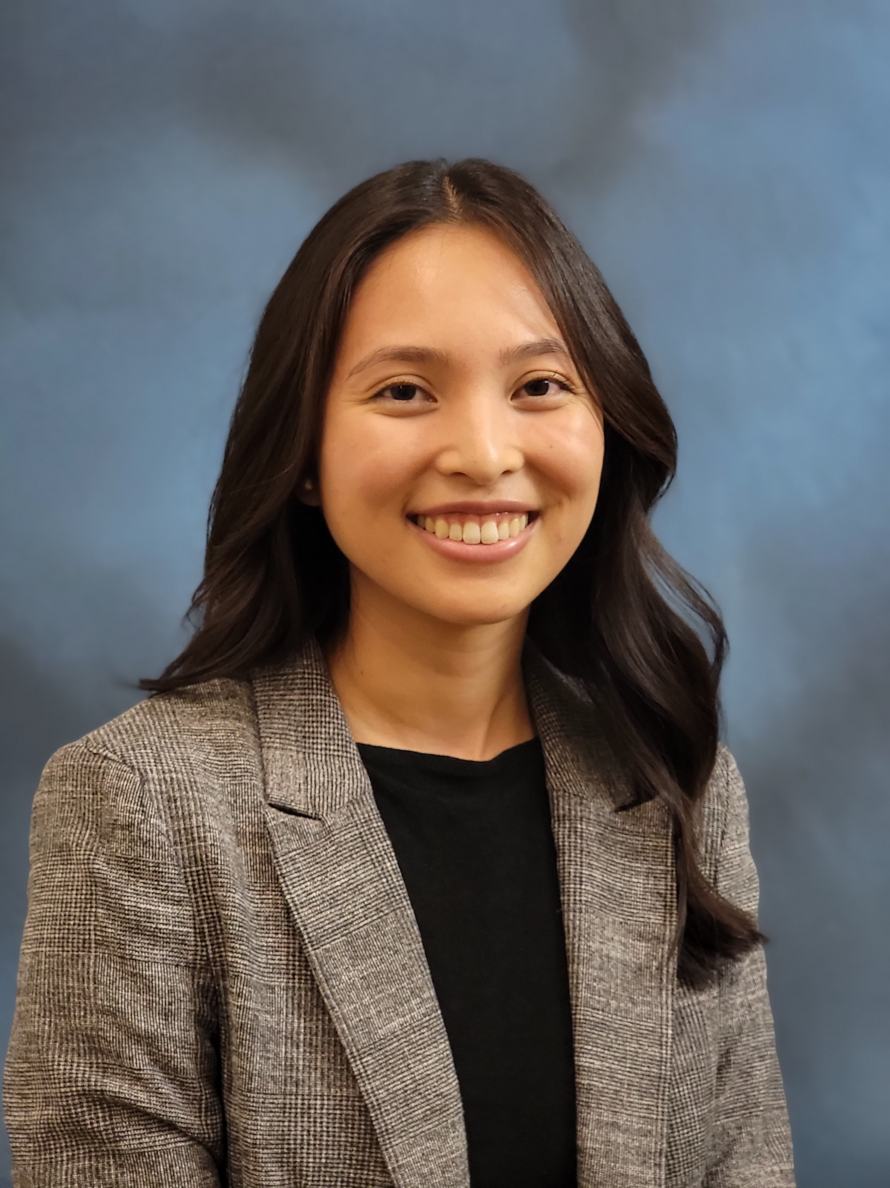
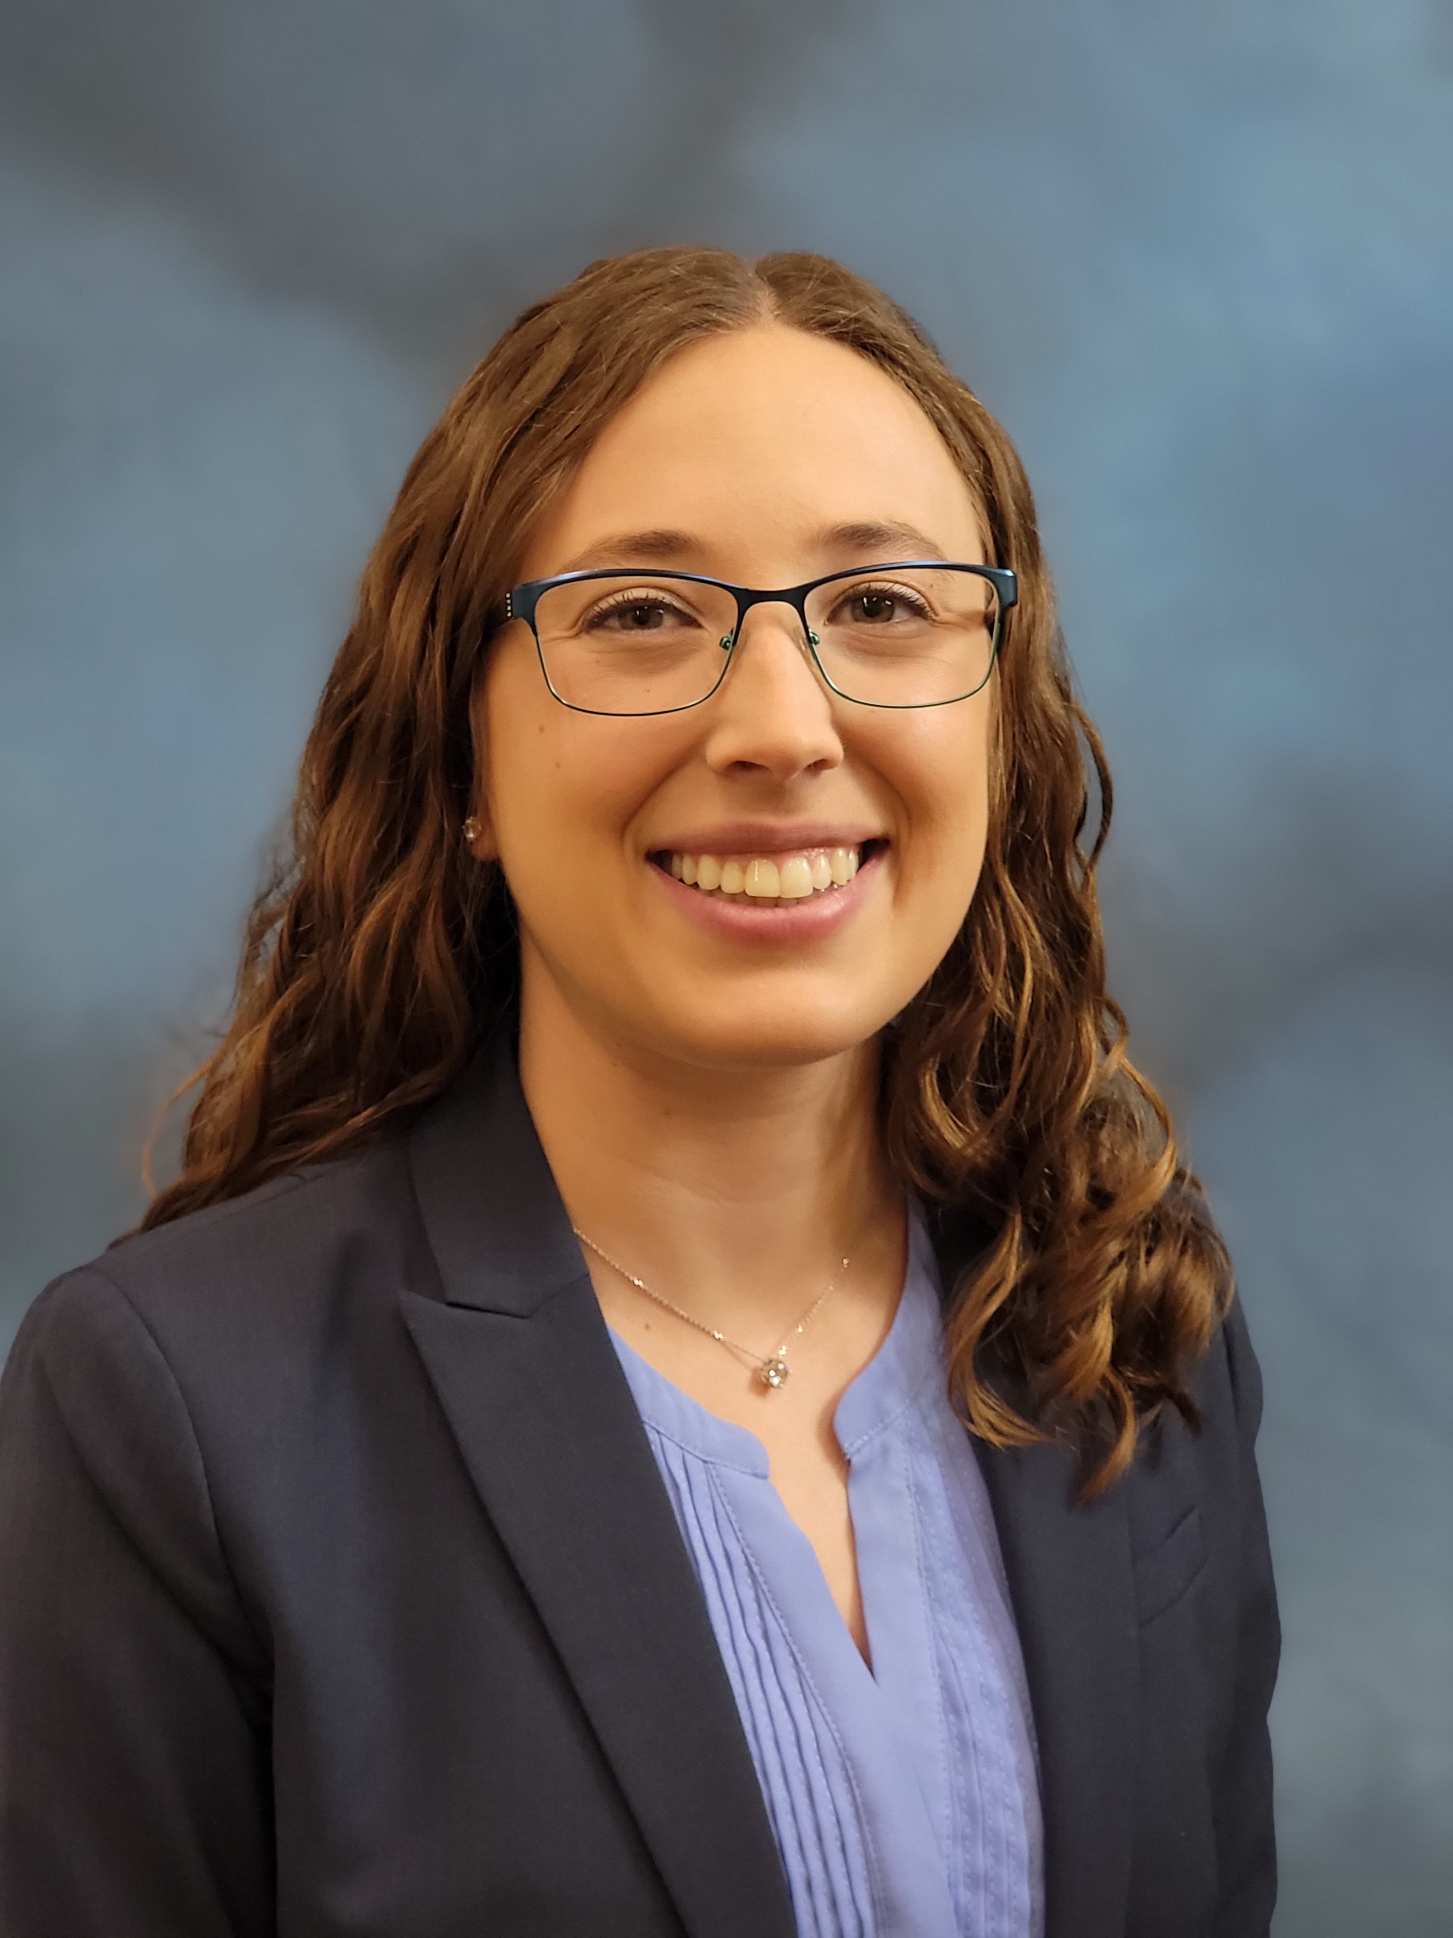
MEET OUR RESIDENTS
Jessica Bhandari,
PGY4
Allison Kraft,
PGY4
Vaish Pochincherla, PGY4
Sloane Booterbaugh,
PGY 3
Emma Flynn-Kopko, PGY3
Rachel Mares,
PGY3
Lydia Cameron,
PGY2
Bailee Reilly, PGY2
Keely Robino,
PGY2
Andrea Done,
PGY1
Nicolette Herbert,
PGY1
Kirsten Tucker,
PGY1

Slide 6
OUR CURRICULUM
First year residents involved in procedures from day 1
Block schedule: 13 blocks per year (4 weeks each)
  All rotations are in the Grand Rapids area, including off-service
  OB Days: 6:30a-5p M-F, weekend call
  OB Nights: 5p-7a Su-Th, no weekend call
Resident continuity clinic
  Assigned to clinic ~one day per week when on ob or gyn service
  First year residents are paired with a senior and start with prenatal visits then progressively work-up to more complex gyn visits throughout residency
  Clinic staffed by Dr. Elderkin

Slide 7
GYNECOLOGIC SURGERY
Surgeries are performed at UM Health-West and Park East Surgical Center
Gyn service hours: 6:30a-5p M-F, weekend call
Most hysterectomies performed by minimally invasive techniques:
  Robotic
  Total laparoscopic
  Single-site laparoscopic
da Vinci Xi Robotic Surgical System:
  Teaching console available at both surgical sites
  Teaching console is equipped with training modules
  Residents graduate with comprehensive robotic training
In-house gyn subspecialties:
  UroGyn: Dr. English & Dr. Hoover
  GynOnc: Dr. Brader

Slide 8
LABOR & DELIVERY
Labor and Delivery:
  10 labor rooms & 6 triage bays
  One attending per week covers L&D days
  Residents responsible for managing all patients and deliveries
  Nurse-run term triage
  Culture of teaching and congeniality with our nurses and staff
Nursery:
  Level 2 Special Care Nursery (deliver 35 weeks and up unless emergent delivery is indicated with capabilities to stabilize any gestational age prior to transfer)
  24-hour NNP coverage with in-house pediatrician during the day
  Opportunities to perform circumcision if interested, not required

Slide 9
PGY 1
6 blocks of OB
  Including 2 night blocks
4 blocks of gyn surgery
½ block of nursery & ½ block of ultrasound
1 block of SICU at Corewell – Butterworth
1 block of emergency department

Slide 10
PGY 2
5 blocks of OB
  Including 2 night blocks
5 blocks of gyn surgery
1 block of inpatient MFM at Corewell - Butterworth
1 block of REI at The Fertility Center
1 block of UroGyn

Slide 11
PGY 3
5 blocks of OB
  1 night block with an intern (in the second half of the year)
5 blocks of gyn surgery
1 block of inpatient MFM at Corewell - Butterworth
1 block of outpatient MFM at Corewell
1 block of GynOnc
Opportunities for an elective block

Slide 12
PGY 4
6 blocks of OB
  1 night block with an intern (in the first half of the year)
5 blocks of gyn surgery
1 block of GynOnc
1 block of UroGyn
Opportunities for an elective block

Slide 13
EDUCATION
Protected ½ day per week
  Simulation once per month (including Noelle & EMIGS sims, and other hands-on learning)
  Lectures by faculty and residents
  Journal Article Review
  Occasional joint education with Emergency Medicine and Family Medicine
Morning readings - review a practice bulletin or other related literature every morning during sign-out
SCS (Statewide Campus System) – all osteopathic Ob/Gyn Residents in Michigan meet once a month (every 3rd Thursday) for lectures from specialists (mostly virtual with special in-person events)
Journal club once per quarter
M&M Conference once per quarter
Several opportunities to attend other conferences and courses throughout the year

Slide 14

WELLNESS
Protected time every 5th Wednesday of the month during education time for ob/gyn residents
  Past wellness events: pottery, pumpkin carving, kayaking, etc.
On-campus Farm Market with local vendors every Thursday from May to October
HealthyBest: employee wellness office
  Gym membership/fitness class discounts
  Financial wellness resources
  Running club & race reimbursements
  Childcare discounts
Encompass: free virtual counseling for all employees

Slide 15
QUESTIONS?
Please reach out to our program coordinator!
Chelsea Cavataio
Chelsea.Cavataio@umhwest.org

